Slide 1



Slide 2
Contents
1
Introducing Searching
Linear Search
2
3
Binary Search

Slide 3

How did you find a name in a phonebook?

Slide 4
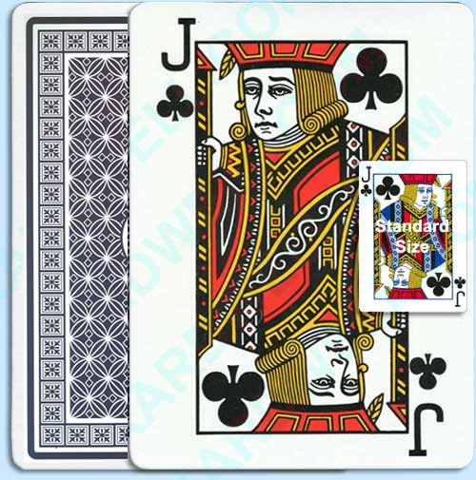
How did you find this card?

Slide 5
Linear Search
I need to find the student whose name is …..

Slide 6
Linear Search
Most basic of search algorithms
Moves sequentially through the array looking for a matching value

Slide 7

Linear Search
LINEAR SEARCH
Best | Average | Worst
O(1) | O(n) | O(n)
Array
Brute-force

Slide 8
Linear Search
When is it best used?
  Small problem set
  Unsorted problem set

Slide 9
Binary Search
1. Everybody stand up
Divide & Conquer
2. Pair off with somebody standing; stay standing if taller, if shorter sit down.
3. If still standing, go to step 2

Slide 10
Binary Search
Relies on a divide and conquer strategy to find a value within an already-sorted collection

Slide 11
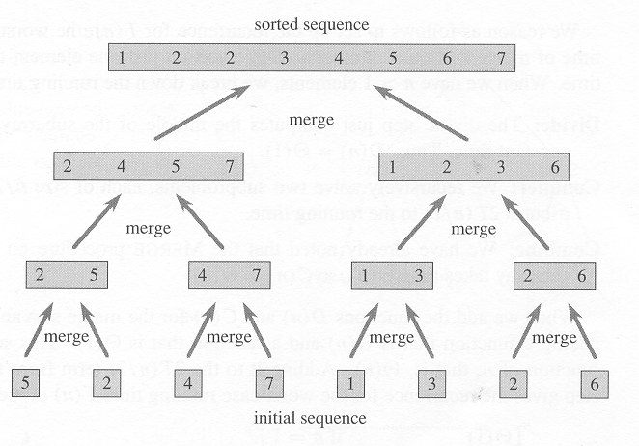
Binary Search
BINARY SEARCH
Best | Average | Worst
O(1) | O(log n) | O(log n)
Array
Divide & Conquer

Slide 12

Do you remember logarithms?
In its simplest form:
  How many of one number do we multiply to get another number?

Slide 13

Do you remember logarithms?

Slide 14
Binary Search
When is it best used?
  On a large problem set
  Sorted problem set

Slide 15
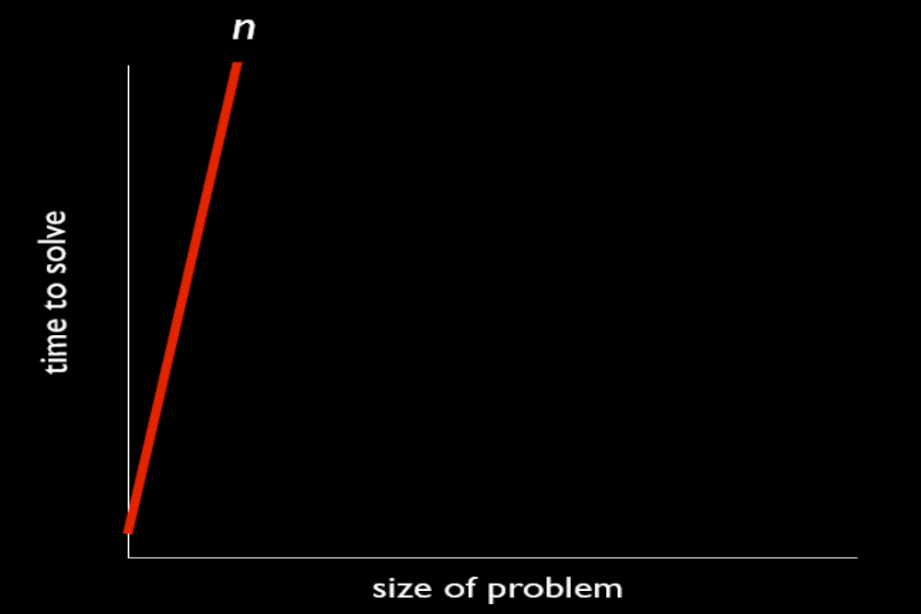
O(n)
  If I count everybody in this class individually - Linear

Slide 16
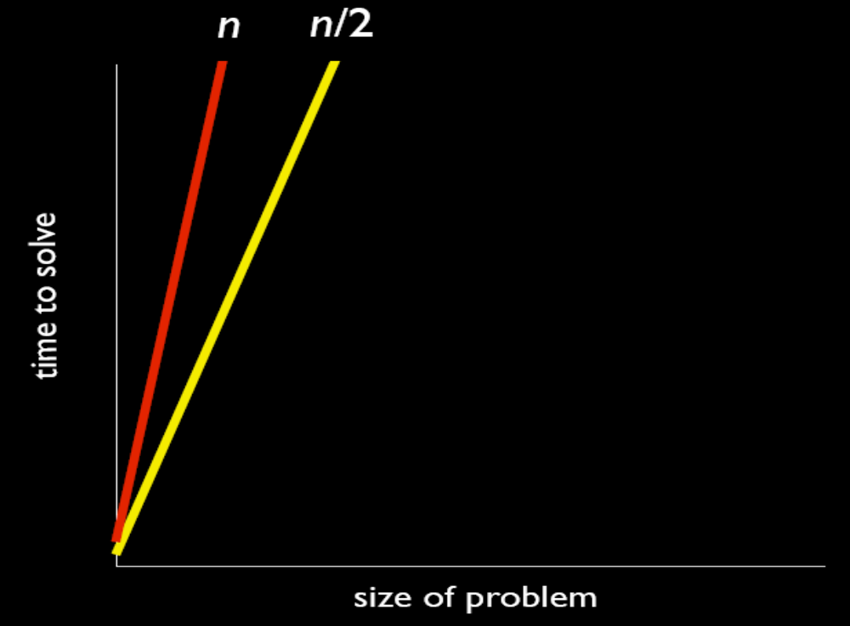
O(n/2)
  If I count the class in pairs

Slide 17
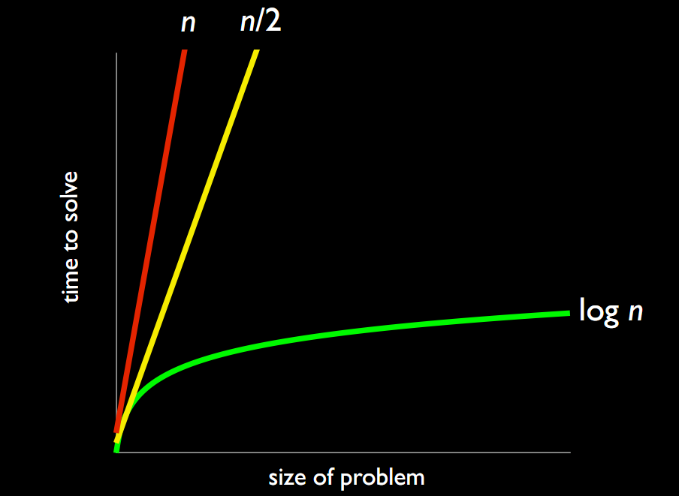
O(Log n)
  If I count the class using the Week 1 algorithm - Binary

Slide 18
Search Algorithms
Write the algorithm to perform a linear search on an array.

Slide 19
Linear Search Algorithm
Input: An array A storing N items, element to be searched for - searchKey
Output: i, position of the searched for element in the array

Slide 20
Linear Search Algorithm
for i = 0, i < n do
if A[i] = searchKey
return i
return -1

Slide 21
Search Algorithms
Write the algorithm to perform a binary search on an array.

Slide 22
Binary Search Algorithm
Determine middle element of subarray
If searchKey is the middle element return its index
Else if searchKey is in the left subarray
  Highest index is the index of the middle element – 1
Else if searchKey is in the right subarray
  Lowest index is the index of the middle element + 1

Slide 23
Binary Search Algorithm
Input: An array A, element to be searched for – searchKey, lowest index of array – low, highest index of array – high.
Output: i, position of the searched for element in the array

Slide 24
Binary Search Algorithm
Middle = (low + high)/2
If searchKey = A[middle]
  return middle
Else if searchKey < A[middle]
  high = middle - 1
Else if searchKey > A[middle]
  low = middle + 1
What is wrong with this algorithm?

Slide 25
Binary Search Algorithm
While low <= high
Middle = (low + high)/2
If searchKey = A[middle]
  return middle
Else if searchKey < A[middle]
  high = middle - 1
Else if searchKey > A[middle]
  low = middle + 1

Slide 26

Binary Search Algorithm
Alter your algorithm to find this card in a pack of playing cards.
Order of suits are:
Hearts
Diamonds
Clubs
Spades

Slide 27
Thank You !

